Slide 1
iOS Application Programming
http://developer.apple.com/library/ios/#documentation/iPhone/Conceptual/iPhoneOSProgrammingGuide/Introduction/Introduction.html
Olga Pronina

Slide 2
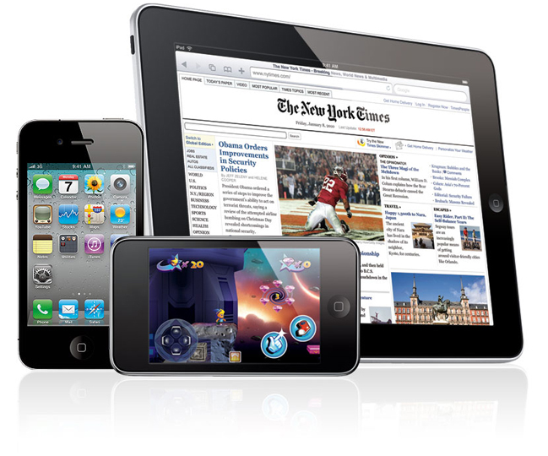
iOS Application Design
This training contains fundamental information about the iOS environment and how your applications interact with that environment. It also contains important information about the architecture of iOS applications and tips for designing key parts of your application.

Slide 3
Application Runtime Environment

Slide 4
Specialized System Behaviors
The core iOS system is based on the same technologies used by Mac OS X. However, there are places where the behavior of iOS differs from that of Mac OS X:
Virtual Memory System - in iOS, each program has its own virtual address space, but the amount of usable virtual memory is constrained by the amount of physical memory available.
Automatic Sleep Timer - when the system does not detect touch events for an extended period of time, it dims the screen initially and eventually turns it off altogether.
Multitasking Support - in iOS 4 and later, multitasking allows applications to run in the background even when they are not visible on the screen.
Notes:
The Virtual Memory System
To manage program memory, iOS uses essentially the same virtual memory system found in Mac OS X. In iOS, each program still has its own virtual address space, but unlike Mac OS X, the amount of usable virtual memory is constrained by the amount of physical memory available. This constraint is because iOS does not support paging to disk when memory gets full. Instead, the virtual memory system simply releases read-only memory pages, such as code pages, when it needs more space. Such pages can always be loaded back into memory later if they are needed again.
If memory continues to be constrained, the system may send notifications to any running applications, asking them to free up additional memory. All applications should respond to this notification and do their part to help relieve the memory pressure. For information on how to handle such notifications in your application, see “Observing Low-Memory Warnings.
The Automatic Sleep Timer
One way iOS saves battery power is through the automatic sleep timer. When the system does not detect touch events for an extended period of time, it dims the screen initially and eventually turns it off altogether.
If you are creating an application that does not use touch inputs, such as a game that relies on the accelerometers, you can disable the automatic sleep timer to prevent the screen from dimming. You should use this timer sparingly and reenable it as soon as possible to conserve power. Only applications that display visual content and do not rely on touch inputs should ever disable the timer. Audio applications or applications that do not need to present visual content should not disable the timer.
The process for disabling the timer is described in “Turning Off Screen Locking.” For additional tips on how to save power in your application, see “Reduce Power Consumption.”

Slide 5
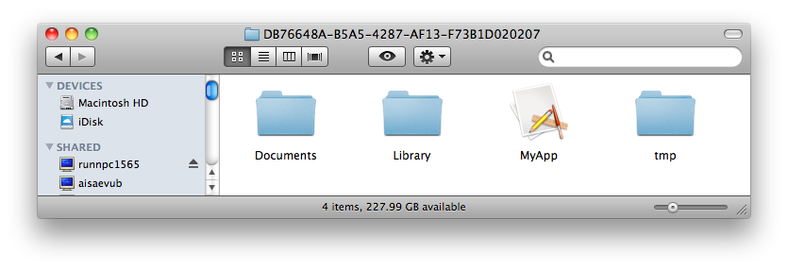
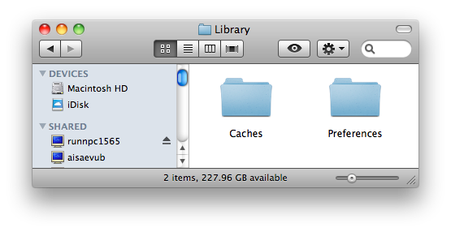
Application Sandbox
<Application_Home>/AppName.app
<Application_Home>/Documents/
<Application_Home>/Library/
<Application_Home>/Library/Preferences
<Application_Home>/Library/Caches
<Application_Home>/tmp/
Notes:
For security reasons, iOS restricts each application (including its preferences and data) to a unique location in the file system.
This restriction is part of the security feature known as the application’s sandbox. The sandbox is a set of fine-grained controls limiting an application’s access to files, preferences, network resources, hardware, and so on. Each application has access to the contents of its own sandbox but cannot access other applications’ sandboxes.
When an application is installed on a device, a home directory is created for the application. There are some of the important subdirectories inside this home directory that you might need to access:
<Application_Home>/AppName.app - this is the bundle directory containing the application itself.
<Application_Home>/Documents/ - use this directory to store user documents and application data files
<Application_Home>/Library/ - this directory is the top-level directory for files that are not user data files
<Application_Home>/Library/Preferences - this directory contains application-specific preference files
<Application_Home>/Library/Caches - use this directory to write any application-specific support files that you want to persist between launches of the application or during application updates
<Application_Home>/tmp/ - use this directory to write temporary files that you do not need to persist between launches of your application

Slide 6
Hardware Support
If your application requires a feature, it should declare its support for that feature by including the UIRequiredDeviceCapabilities key in its Info.plist file.
For features that are not required, but which you might want to support when they are present, check to see if the feature is available before trying to use it.
To obtain general information about device- or application-level features, use the methods and properties of the UIDevice and UIApplication classes.
For example, to get the current battery level of the device:
float batteryLevel = [UIDevice currentDevice].batteryLevel;
Here you can find table that lists the techniques for determining whether certain types of hardware or features are available.

Slide 7
Core Application Design

Slide 8
Fundamental Design Patterns
Model-View-Controller (MVC) design pattern is a way of dividing your code into independent functional areas.
Delegation is a simple and powerful pattern in which one object in a program acts on behalf of, or in coordination with, another object..
Controls use the target-action design pattern to notify your application of user interactions.
Useful links: Model-View-Controller, Delegation, Target-action

Slide 9
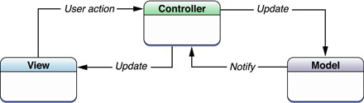
Model-View-Controller
The model portion defines your application’s underlying data engine and is responsible for maintaining the integrity of that data.
The view portion defines the user interface for your application and has no explicit knowledge of the origin of the data displayed in that interface.
The controller portion acts as a bridge between the model and view and coordinates the passing of data between them.

Slide 10
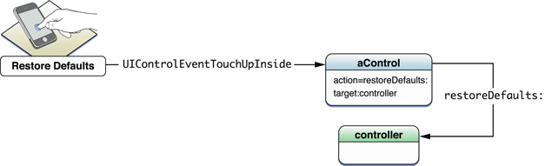
Target-Action
Target-action is a design pattern in which an object holds the information necessary to send a message to another object when an event occurs. The stored information consists of two items of data: an action selector, which identifies the method to be invoked, and a target, which is the object to receive the message. The message sent when the event occurs is called an action message.

Slide 11
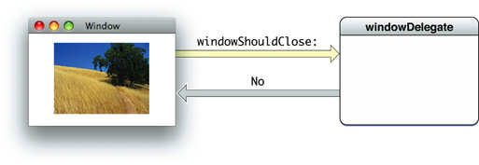
Delegation
An example of a delegating object is an instance of the NSWindow class of the AppKit framework. NSWindow declares a protocol, among whose methods is a target="_self" windowShouldClose:/a. When a user clicks the close box in a window, the window object sends windowShouldClose: to its delegate to ask it to confirm the closure of the window. The delegate returns a Boolean value, thereby controlling the behavior of the window object.

Slide 12
Core Application Objects
The role of objects in an iOS application:
UIApplication - manages the application event loop and coordinates other high-level behaviors for your application.
Application delegate - This object works in tandem with the UIApplication object to handle app initialization, state transitions, and many high-level app events.
Data model - stores your application’s content and is therefore specific to your application.
View Controllers - manages the presentation of your application’s content on screen.
UIWindow - coordinates the presentation of one or more views on the device screen or on an external display
Views, Controls and Layers - provide the visual representation of your application’s content

Slide 13
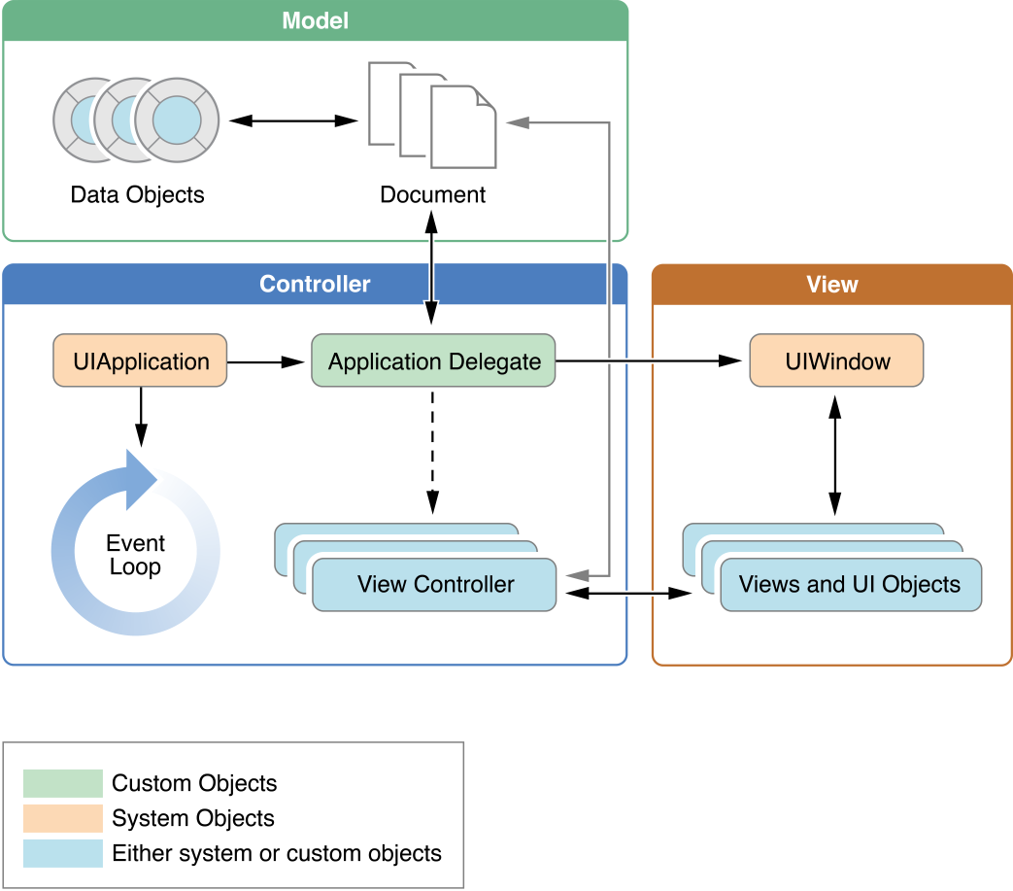
Application structure

Slide 14
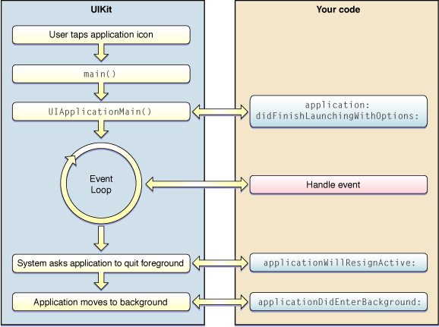
Application Life Cycle
Figure below depicts the simplified startup life cycle for a newly launched iOS application.

Slide 15
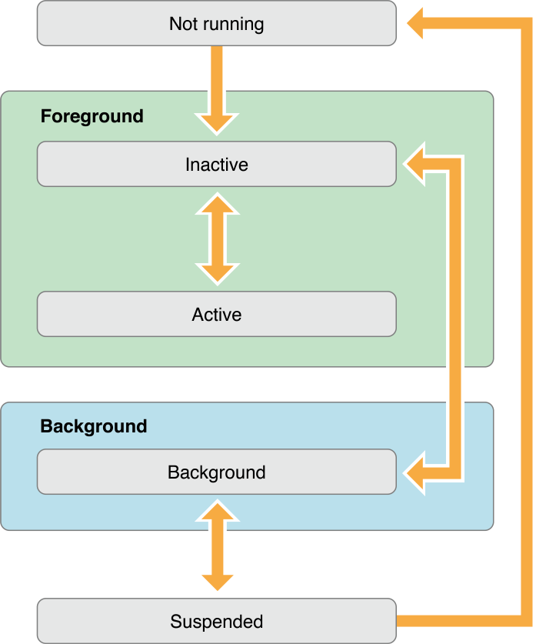
Application’s States
Not running - application has not been launched or was running but was terminated by the system
Inactive - application is running in the foreground but is currently not receiving events
Active - application is running in the foreground and is receiving events
Background - application is in the background and executing code
Suspended - application is in the background but is not executing code. The system moves application to this state automatically. If this state is not available, applications are terminated and moved to the not running state instead.

Slide 16
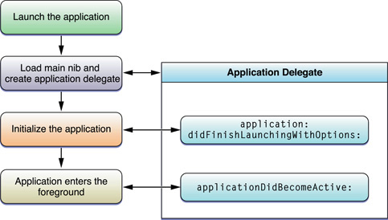
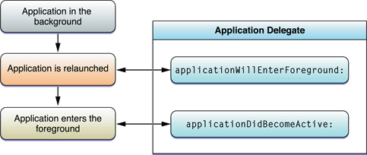
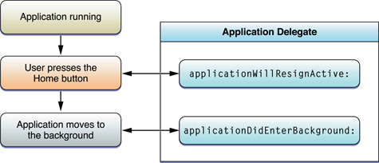
Application’s States and Transitions
Launching into the active state:
Moving from the foreground to the background:
Transitioning from the background to the foreground:

Slide 17
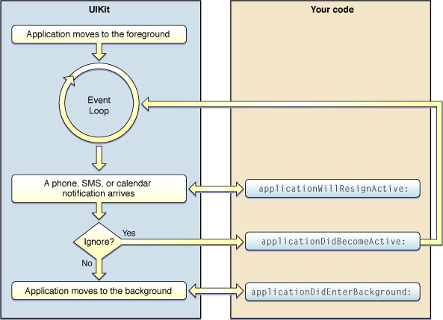
Responding to Interruptions
Figure below shows the steps of handling application interruptions.
to Inactive state
to Active state
to Background state

Slide 18
Data Visualization
Graphics and Drawing System
Use native drawing technologies (such as Core Graphics and UIKit)
Use OpenGL ES
Text System
Different languages have different text input requirements, and so the keyboard adapts as needed to support different input methods.
For simple text display and editing, you can use the UILabel, UITextField, and UITextView classes.
Audio and Video Support
For video playback, use the Media Player and AV Foundation frameworks.
For audio playback, you can use the same frameworks plus the Core Audio and OpenAL frameworks.

Slide 19
Integration with System
There are some of features you can incorporate into your applications:
The user’s contacts
Systemwide calendar and time-based events
The Mail and Messages applications
Telephony information
For example, if you want to use Address Book:
ABAddressBookRef addressBook;
CFErrorRef error = NULL;
addressBook = ABAddressBookCreate();
/* work with Address Book */
ABAddressBookSave(addressBook, &error);
CFRelease(addressBook);
You can find useful links in Integration with the Hardware and System Applications

Slide 20
Events

Slide 21
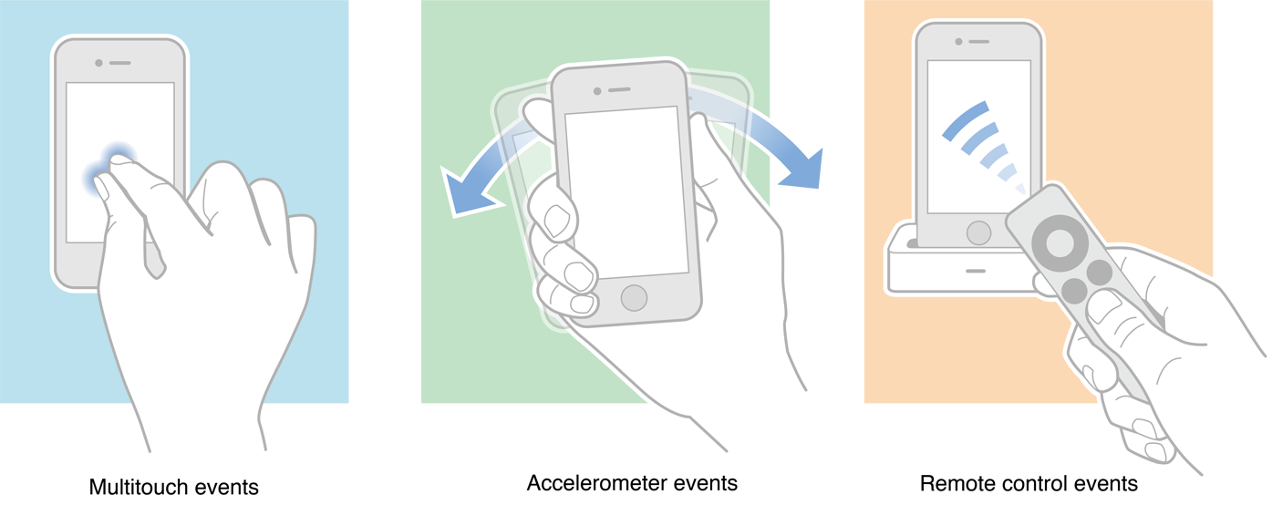
Events
Events are objects sent to an application to inform it of user actions: multitouch events, motion events and events for controlling multimedia (remote-control event).

Slide 22
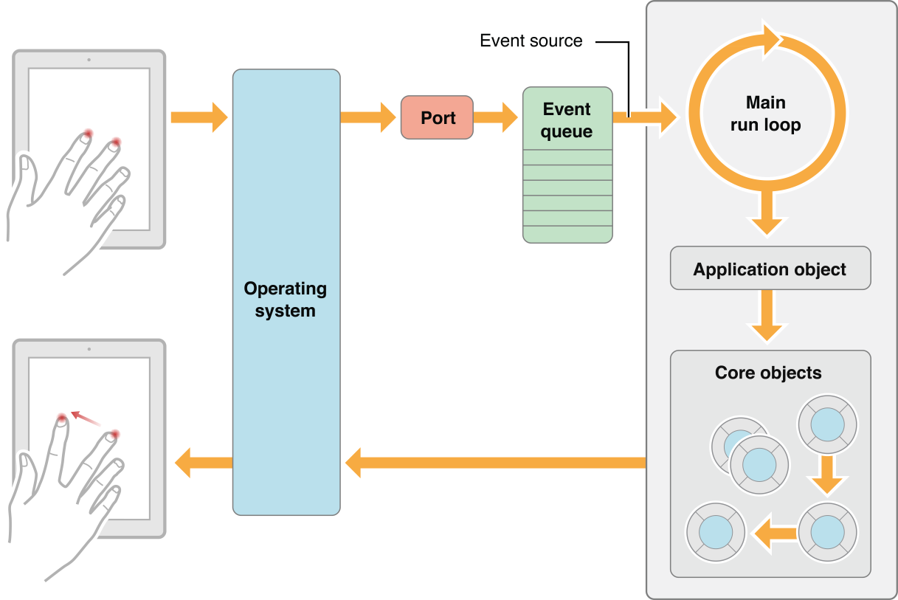
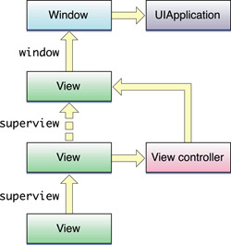
Event-Handling System
As events come into the application, they are queued until the application is ready to process them.
Most events sent to an application are encapsulated in an event object—an instance of the UIEvent class.
In the case of touch-related events, the event object contains one or more touch objects (UITouch) representing the fingers that are touching the screen.
Notes:
Distributing and handling events is the job of responder objects, which are instances of the UIResponder class.
The UIApplication, UIViewController, UIWindow, and UIView classes are all descendants of UIResponder. After pulling an event off the event queue, the application dispatches that event to the UIWindowobject where it occurred. The window object, in turn, forwards the event to its first responder. In the case of touch events, the first responder is typically the view object (UIView) in which the touch took place. For example, a touch event occurring in a button is delivered to the corresponding button object.
If the first responder is unable to handle an event, it forwards the event to its next responder, which is typically a parent view or view controller. If that object is unable to handle the event, it forwards it to its next responder, and so on until the event is handled. This series of linked responder objects is known as the responder chain. Messages continue traveling up the responder chain—toward higher-level responder objects such as the window, the application, and the application’s delegate—until the event is handled. If the event isn't handled, it is discarded.

Slide 23
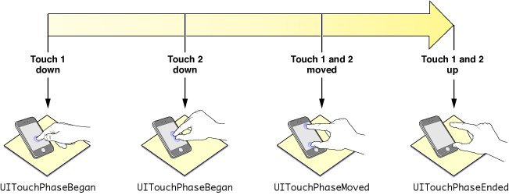
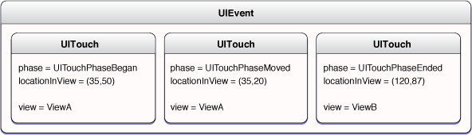
Multitouch Events
iOS recognizes one or more fingers touching the screen as part of a multitouch sequence
An event object contains all touch objects for the current multitouch sequence and can provide touch objects specific to a view or window

Slide 24
Handling Multitouch Events
For example, to detect a double-tap gesture:
- (void)touchesBegan:(NSSet *)touches withEvent:(UIEvent *)event {
}
- (void)touchesMoved:(NSSet *)touches withEvent:(UIEvent *)event {
}
- (void)touchesEnded:(NSSet *)touches withEvent:(UIEvent *)event {
for (UITouch *touch in touches) {
if (touch.tapCount >= 2) {
[self.superview bringSubviewToFront:self];
}
}
}
- (void)touchesCancelled:(NSSet *)touches withEvent:(UIEvent *)event {
}
Notes:
You can find more information about multitouch events in Event Handling Guide

Slide 25
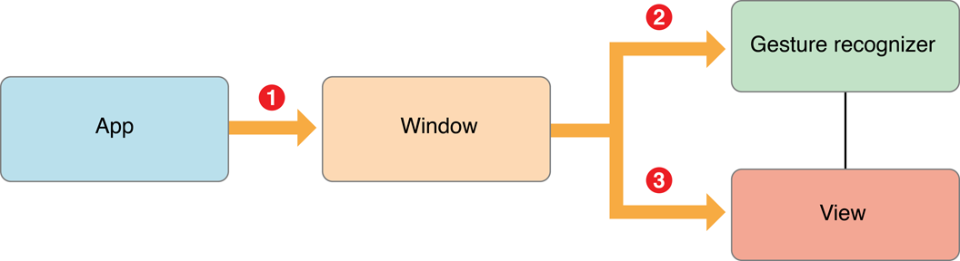
Gesture Recognizers
UIGestureRecognizer is the abstract base class for concrete gesture-recognizer subclasses
To detect its gestures, a gesture recognizer must be attached to the view that a user is touching - hit-tested view
Thus gesture recognizers act as observers of touch objects sent to their attached view or view hierarchy
Notes:
To help applications detect gestures, iOS 3.2 introduces gesture recognizers, objects that inherit directly from the UIGestureRecognizer class.
Recall that events in iOS are represented by represented by UIEvent objects, and each event object encapsulates the UITouch objects of the current multitouch sequence. A set of those UITouchobjects is specific to a given phase of a multitouch sequence.
Delivery of events initially follows the usual path: from operating system to the application object to the window object representing the window in which the touches are occurring. But before sending an event to the hit-tested view, the window object sends it to the gesture recognizer attached to that view or to any of that view’s subviews.

Slide 26
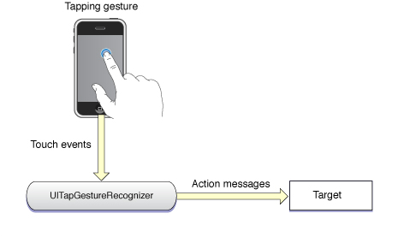
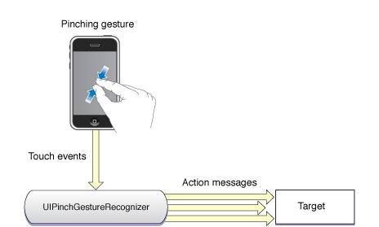
Discrete and Continuous Gestures
Discrete gesture, such as a double-tap, happens just once - when a gesture recognizer recognizes a discrete gesture, it sends its target a single action message
Continuous gesture, such as pinching, takes place over a period - gesture recognizer sends action messages to its target at short intervals until the multitouch sequence ends

Slide 27
Implementing Gesture Recognition
For example, to create double-tap gesture:
UITapGestureRecognizer *singleFingerDTap =
[[UITapGestureRecognizer alloc]
initWithTarget:self action:@selector(handleSingleDoubleTap:)];
singleFingerDTap.numberOfTapsRequired = 2;
[self.theView addGestureRecognizer:singleFingerDTap];
[singleFingerDTap release];
...
- (IBAction)handleSingleDoubleTap:(UIGestureRecognizer *)sender {
CGPoint tapPoint = [sender locationInView:sender.view.superview];
[UIView beginAnimations:nil context:NULL];
sender.view.center = tapPoint;
[UIView commitAnimations];
}

Slide 28
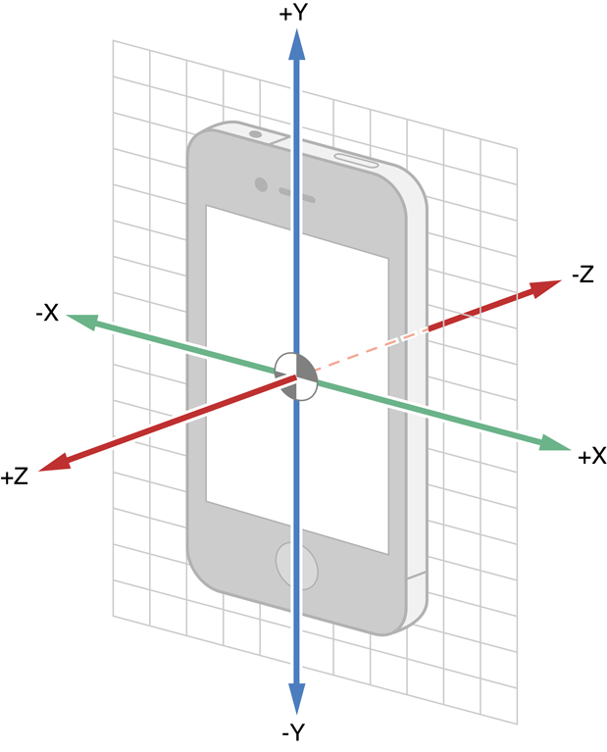
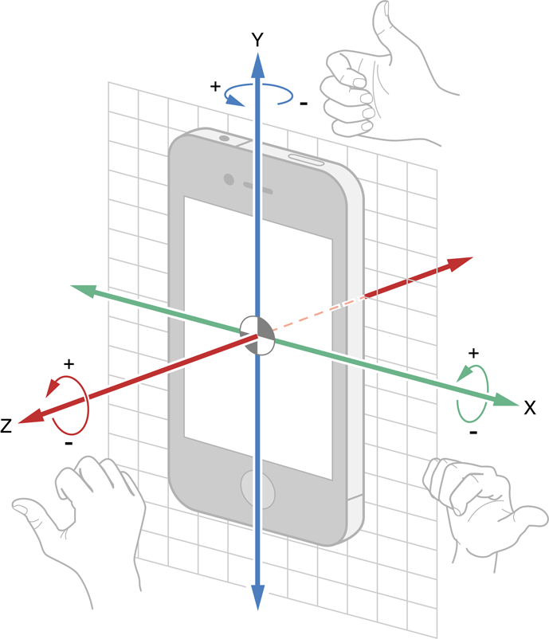
Motion Events
iPhone, iPad, or iPod touch device generates motion events when users move the device in a certain way, such as shaking it or tilting it
Notes:
Core Motion defines a manager class, CMMotionManager, and three classes whose instances encapsulate measurements of motion data of various types:
A CMAccelerometerData object encapsulates a data structure that records a measurement of device acceleration along the three spatial axes. This data derives from the accelerometer.
For more on CMAccelerometerData, see “Handling Accelerometer Events Using Core Motion.”
A CMGyroData object encapsulates a data structure that records a biased estimate of a device’s rate of rotation along the three spatial axes. This “raw” data derives from the gyroscope. (“Biased” in this context refers to an offset from the true rotation rate. Thus, if the device is not rotating, this estimate from the gyroscope will still give a non-zero value.)
For more on CMGyroData, see “Handling Rotation-Rate Data.”
A CMDeviceMotion object encapsulates processed device-motion data that derives from both the accelerometer and the gyroscope. Core Motion’s sensor fusion algorithms process both accelerometer and gyroscope data and provide an application with highly accurate measurements of device attitude, the (unbiased) rotation rate of a device, the direction of gravity on a device, and the acceleration that the user is giving to a device. A CMAttitude object, which is contained in anCMDeviceMotion instance, contains properties giving different measurements of attitude, including the Euler angles indicated by roll, pitch, and yaw.
Attitude refers to the orientation of a device in three dimensions relative to a reference frame that is external to the device. For more on attitude andCMDeviceMotion, see “Handling Processed Device-Motion Data.”

Slide 29
UIAccelerometer
UIAccelerometer* theAccelerometer =
[UIAccelerometer sharedAccelerometer];
theAccelerometer.updateInterval = 0.01;
theAccelerometer.delegate = self;
...
- (void)accelerometer:(UIAccelerometer *)accelerometer
didAccelerate:(UIAcceleration *)acceleration{
UIAccelerationValue x, y, z;
x = acceleration.x;
y = acceleration.y;
z = acceleration.z;
}

Slide 30
Remote-Control Events
- (void)viewDidAppear:(BOOL)animated {
[super viewDidAppear:animated];
[[UIApplication sharedApplication]
beginReceivingRemoteControlEvents];
[self becomeFirstResponder];
}
...
- (void) remoteControlReceivedWithEvent: (UIEvent *) receivedEvent {
if (receivedEvent.type == UIEventTypeRemoteControl) {
...}
}
...
- (void)viewWillDisappear:(BOOL)animated {
[super viewWillDisappear:animated];
[[UIApplication sharedApplication]
endReceivingRemoteControlEvents];
[self resignFirstResponder];
}

Slide 31
View Programming

Slide 32
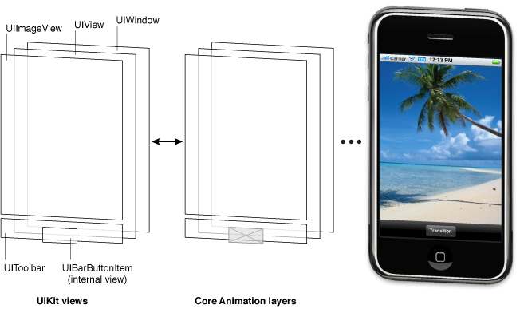
View Architecture

Slide 33
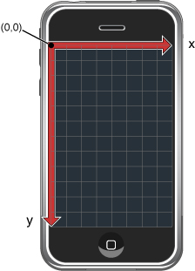
View Coordinate System
Every view instance defines and maintains its own coordinate system, and all drawing is done relative to this coordinate system.
All coordinate values and distances are specified using floating-point values in units referred to as points.
iPhone and iPod touch - 320 x 480 points
iPad - 768 x 1024 points

Slide 34
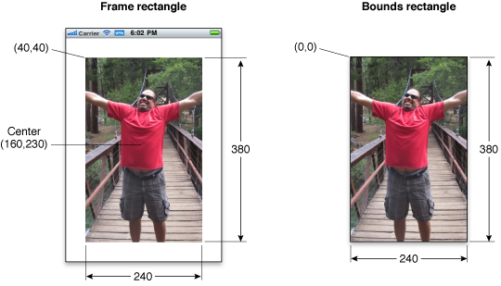
Frame, Bounds, and Center Properties
Frame property contains the frame rectangle, which specifies the size and location of the view in its superview’s coordinate system
Center property contains the known center point of the view in the superview’s coordinate system.
Bounds property contains the bounds rectangle, which specifies the size of the view (and its content origin) in the view’s own local coordinate system

Slide 35
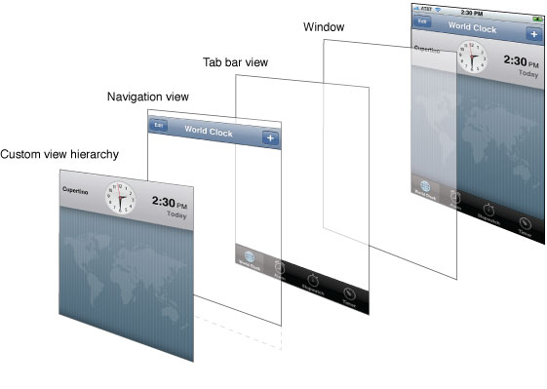
View Hierarchy
Managing view hierarchies is a crucial part of developing your application’s user interface

Slide 36
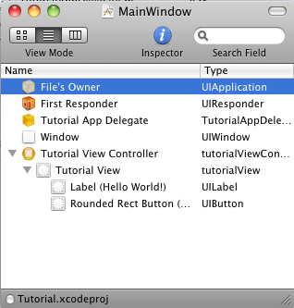
Locating Views
There are two ways to locate views in a view hierarchy:
Store pointers to any relevant views in an appropriate location, such as in the view controller that owns the views – it is the most common approach and makes accessing those views very convenient (especially if you use Interface Builder).
Assign a unique integer to each view’s tag property and use the viewWithTag: method to locate it - a useful way to reduce hard-coded dependencies and support more dynamic and flexible solutions.

Slide 37
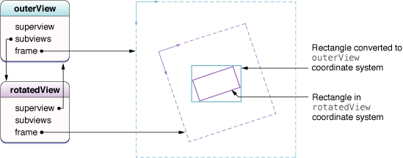
Converting Coordinates
convertPoint:fromView: and convertRect:fromView: methods convert coordinates from some other view’s coordinate system to the local coordinate system (bounds rectangle) of the current view
convertPoint:toView: and convertRect:toView: methods convert coordinates from the current view’s local coordinate system (bounds rectangle) to the coordinate system of the specified view

Slide 38
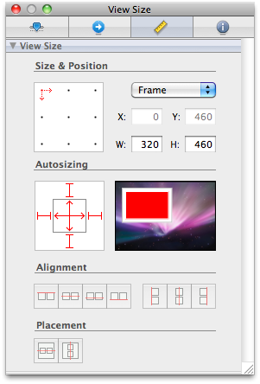
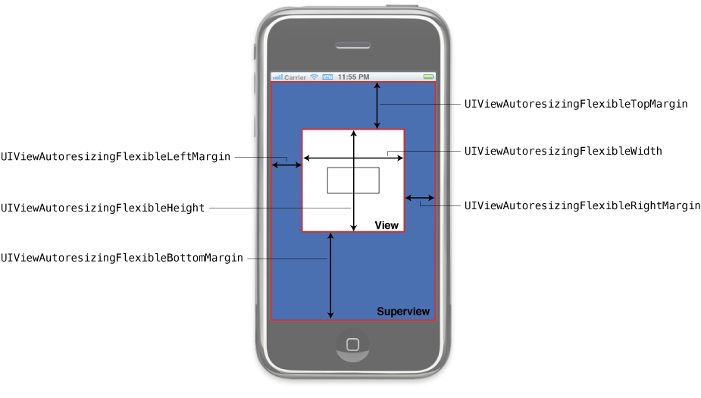
Autoresizing constants

Slide 39
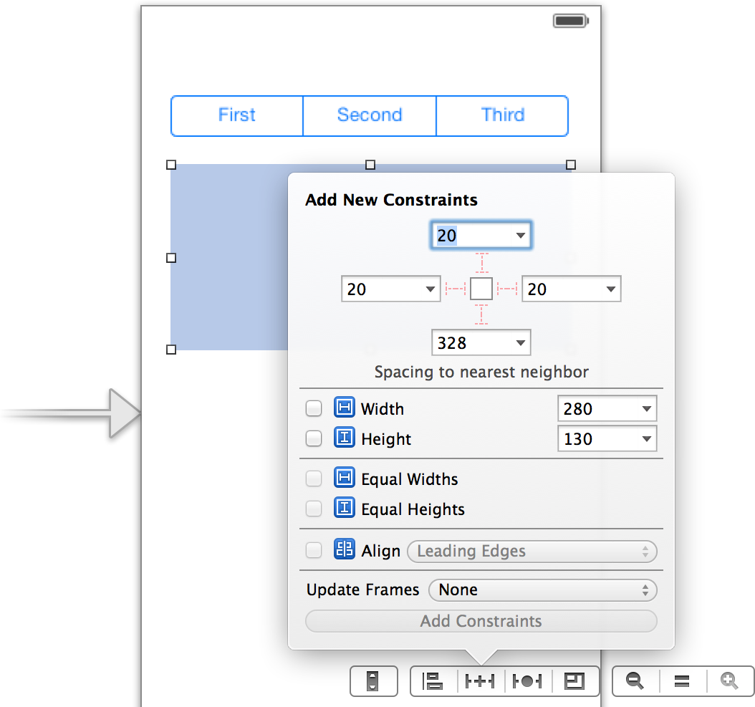
Auto Layout

Slide 40
Common Application Behaviors

Slide 41
Paths to Application Directories
NSDocumentDirectory – constant for <Application_Home>/Documents
NSCachesDirectory – constant for <Application_Home>/Library/Caches
NSApplicationSupportDirectory – constant for <Application_Home>/Library/Application Support
NSTemporaryDirectory – function to get <Application_Home>/tmp
NSSearchPathForDirectoriesInDomains – function to get a list of path strings for the specified directories in the specified domains
For the domain, specify the NSUserDomainMask constant to restrict the search to your application
Notes:
NSArray * NSSearchPathForDirectoriesInDomains (
NSSearchPathDirectory directory,
NSSearchPathDomainMask domainMask,
BOOL expandTilde );
Creates a list of path strings for the specified directories in the specified domains. The list is in the order in which you should search the directories. If expandTilde is YES, tildes are expanded as described in stringByExpandingTildeInPath.

Slide 42
Sharing Files with the User
To enable file sharing for your application, do the following:
Add the UIFileSharingEnabled key to your application’s Info.plist file and set the value of the key to YES
Put whatever files you want to share in your application’s Documents directory
If you do not want files to be shared with the user, you should put them somewhere in your application’s Library directory
File sharing does not allow you to share files directly with other applications on the same or a different device
When the device is plugged into the user’s computer, iTunes displays a File Sharing section in the Apps pane of the selected device. The user can add files to this directory or move files to the desktop.

Slide 43
Custom File Formats
In order to support custom file formats, your application must:
Register the file types your application supports with the system
Include the CFBundleDocumentTypes key in its Info.plist file
CFBundleDocumentTypes key contains an array of dictionaries, each of which identifies information about a single document type
Implement the proper methods to open files (when asked to do so by the system)
For more information about Custom File Formats see Implementing Support for Custom File Formats

Slide 44
Communicating with Other Applications
A custom URL scheme is a mechanism through which third-party applications can communicate with each other.
Some applications use URL schemes to initiate specific requests.
You can implement your own URL schemes to facilitate similar types of communications in your applications.
Apple provides built-in support for the http, mailto, tel, and sms URL schemes.
To communicate with an application using a custom URL:
create an NSURL object with some properly formatted content
pass that object to the openURL: method of the shared UIApplication object
The openURL: method launches the application that registered to receive URLs of that type and passes it the URL.

Slide 45
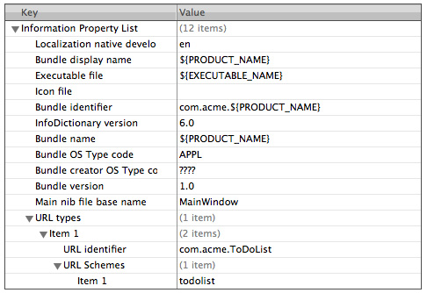
Implementing Custom URL Schemes
To register a URL type for your application, include the CFBundleURLTypes key in your application’s Info.plist file.
Keys and values of the CFBundleURLTypes property:
CFBundleURLName - string containing the abstract name of the URL scheme
CFBundleURLSchemes - array of strings containing the URL scheme names
Defining a custom URL scheme in the Info.plist file:

Slide 46
Test your Custom URL Scheme
Build, install, and run your application
Go to the Home screen and launch Safari
In the address bar of Safari, type a URL that uses your custom scheme
Verify that your application launches and that the application delegate is sent a application:handleOpenURL: message

Slide 47
Handling URL Requests
To handle incoming URLs, your delegate should implement the following methods:
application:didFinishLaunchingWithOptions: method to retrieve information about the URL and decide whether you want to open it
application:openURL:sourceApplication:annotation: method to open the file (iOS 4.2 and later)
application:handleOpenURL: method to open the file (iOS 4.1 and earlier)
Be sure to validate the input you get from URLs passed to your application; see “Validating Input” in Secure Coding Guide to find out how to avoid problems related to URL handling. To learn about URL schemes defined by Apple, see Apple URL Scheme Reference.

Slide 48
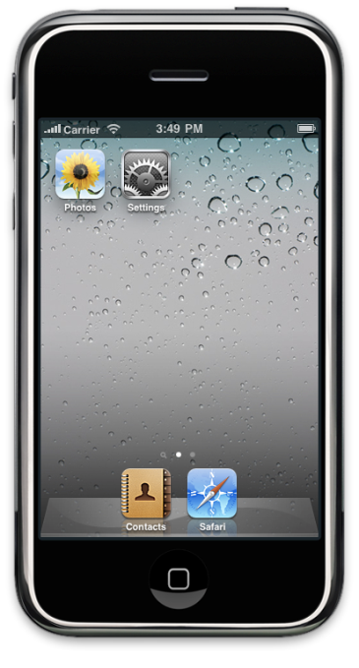
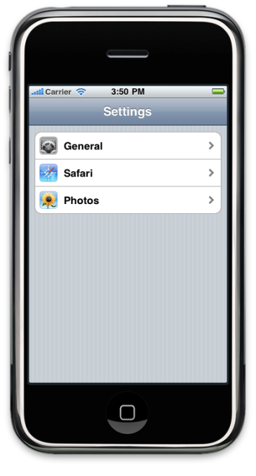
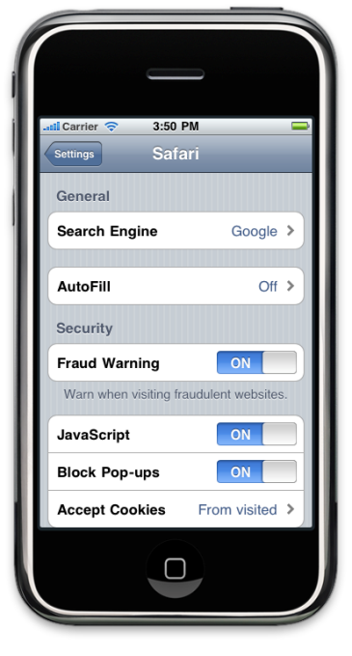
Displaying Application Preferences
You should expose application preferences to the user depending on how integral they are to your program:
Preferences that the user might change frequently should be presented from inside your application using a custom interface
Preferences that are not likely to change frequently should be handled using a Settings bundle
Settings bundle is a custom resource that you create using Xcode:
Notes:
You should expose application preferences to the user depending on how integral they are to your program:
Preferences that the user might change frequently should be presented from inside your application using a custom interface
Preferences that are not likely to change frequently should be handled using a Settings bundle
Settings bundle is a custom resource that you create using Xcode:
contains a specification for how the Settings application should display your preferences
indicates what controls and labels should be displayed
indicates how values entered by the user should be saved to the preferences database
contains custom images for controls that support them

Slide 49
Turning Off Screen Locking
If an iOS-based device does not receive touch events for a specified period of time, it turns off the screen and disables the touch sensor.
If an application does not rely on touch events, you can disable this feature:
set the idleTimerDisabled property of the shared UIApplication object to YES
Screen locking should be disabled only while the user is actively engaged with the application:
be sure to reset this property to NO at times when your application does not need to prevent screen locking

Slide 50
Build-Time Configuration Details

Slide 51
Application Bundle
The contents of a typical iOS application bundle, which for demonstration purposes here is called MyApp:
MyApp – executable file containing your application’s code
Info.plist – file containing configuration data for the application
MainWindow.nib – file containing the default interface objects to load at application launch time
Settings.bundle – file package that you use to add application preferences to the Settings application
Language-specific project directories – localized resources
Your application bundle can include some more files, such as Application icons, iTunesArtwork, Nonlocalized resources.

Slide 52
Access application’s resource files
At runtime, you can access your application’s resource files from your code using the following steps:
Obtain your application’s main bundle object (typically using the NSBundle class)
Use the methods of the bundle object to obtain a file-system path to the desired resource file
Open (or access) the file and use it

Slide 53
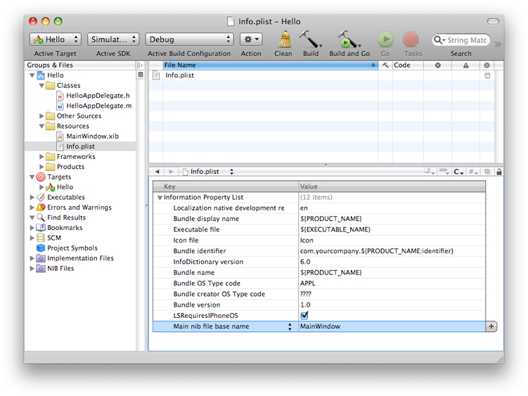
Information Property List (Info.plist)
For detailed information about keys that you can include in your application’s Info.plist file, see Information Property List Key Reference.

Slide 54
Application Icons
Every application must provide an icon to be displayed on a device’s Home screen.
Application may actually specify several different icons for use in different situations.
To specify the icons for your application:
add the CFBundleIconFiles key to your application’s Info.plist file
add the filenames of your icon image to the associated array
image files must be in the PNG format and reside in the top-level of your application bundle
Sizes for images in the CFBundleIconFiles key (iPhone):
Application icon (required) - 57 x 57 pixels
Settings/Search results icon - 29 x 29 pixels

Slide 55
Creating a Universal Application
Universal application is a single application that is optimized for iPhone, iPod touch, and iPad devices.
Configuring Your Xcode Project:
New project - use the Window-based application template
Updating an existing project:
In the Targets section, select the target you want to update to a universal application
Select Project > Upgrade Current Target for iPad and follow the prompts to create one universal application
You should always use the Upgrade Current Target for iPad command to migrate existing projects. Do not try to migrate files manually.

Slide 56
Tuning for Performance and Responsiveness

Slide 57
Factors you should consider
Do not block the Main Thread
always move long-running tasks onto background threads
Use Memory Efficiently
make it a high priority to reduce the amount of memory used by your application
Reduce Power Consumption
optimizing your use of CPU, network, Core Location framework, accelerometers, disk
Tune Your Code
Improve File Access Times
Always use Instruments to improve your application

Slide 58
Questions?

Slide 59
Revision History
Name | Comment | Revision | Date
Olga Pronina | Initial version | 0.1 | 01/14/2011
Vladimir Tyutin | Approved | 1.0 | 01/18/2011

